Slide 1
Critical Thinking About Evidence:
Bayesian Belief Network
ENVE 727 - Winter 2018 - Drexel University
Tyler Bradley
Nicola Horscroft
Charlotte Navrot
Sarina Tufano

Slide 2
Background: What We Know
In 1999 a high school student was arrested for killing his ex-girlfriend
An acquaintance of the suspect and the victim gave the damning evidence
X ex boyfriend
J acquaintance
O all other suspects

Slide 3
Objective: Likelihood of Committing a Crime
Evidence
1: X lent J his phone and car for much of the day
2: X asked the victim for a ride after school (she declined)
3: X had smoked marijuana around the time of the murder and was anxious when being questioned by police
4: J implicated X as the murderer, even though this made himself an accessory
5: X’s cell phone was used to call a number only X knew when X claims J had the phone
According to Bureau of Justice’s 2015 article “Female Victims of Violence,” female victims are murdered by:
24% by spouse or ex-spouse
21% by boyfriend or girlfriend
19% by family member
25% by others they knew
10% by strangers

Slide 4
Methods: Use of Bayesian Belief to Determine Culprit
A decision network with only uncertain events, no choices
Conditional probabilities of evidence conditional on whether each person is guilty are used rather than the reverse since they are easier to ascertain
Bayes’ Rule for 3 probabilities:
Where i represents the suspect and evid. means the evidence in question
$$Prob\left[i | evid.\right]= \frac{\left.P\left[evid. | i\right]∗P[i\right]}{P\left[evid. | X\right]∗P\left[X\right]+P\left[evid. | J\right]∗P\left[J\right]+P\left[evid. | O\right]∗P\left[O\right] }$$

Slide 5





Equations:
1.
2.
3.
4.
5.
$$P[i|lent car to J]=\frac{\left.P[lent car|i]∗P[i\right]}{\left(P[lent car|X]∗P[X])+(P[lent car|J]∗P[J])+(P[lent car|O]∗P[O]\right)}$$
$$P[i|AFR]=\frac{\left.P[AFR|i]∗P[i\right]}{\left(P[AFR|X]∗P[X])+(P[AFR|J]∗P[J])+(P[AFR|O]∗P[O]\right)}$$
$$P[i|smoked]=\frac{\left.P[smoked|i]∗P[i\right]}{\left(P[smoked|X]∗P[X])+(P[smoked|J]∗P[J])+(P[smoked|O]∗P[O]\right)}$$
$$P[i|AATF]=\frac{\left.P[AATF|i]∗P[i\right]}{\left(P[AATF|X]∗P[X])+(P[AATF|J]∗P[J])+(P[AATF|O]∗P[O]\right)}$$
$$P[i|phone call]=\frac{\left.P[phone call|i]∗P[i\right]}{\left(P[phone call|X]∗P[X])+(P[phone call|J]∗P[J])+(P[phone call|O]∗P[O]\right)}$$

Slide 6

Analysis

Slide 7
Prior and Likelihood Probabilities
Prior Probabilities
Suspect | Prior Probabilities
X | 0.20
J | 0.10
O | 0.70
The prior probabilities were determined from Bureau of Justices Statistics for female victims.
Since X was an ex-boyfriend, it was set to 0.2, J was an acquaintance and set to 0.1, and all others were set to 0.7.
The likelihood probabilities are the probability that given the evidence suspect, i, is guilty.
Likelihood Probabilities
Suspect | Evidence 1 | Evidence 2 | Evidence 3 | Evidence 4 | Evidence 5
X | 0.15 | 0.20 | 0.20 | 0.70 | 0.10
J | 0.10 | 0.05 | 0.05 | 0.35 | 0.05
O | 0.05 | 0.01 | 0.01 | 0.01 | 0.02
The likelihood probabilities were determined as a group after listening to the background information on the Serial Podcast.

Slide 8
Posterior Probabilities
Suspect | Evidence 1 | Evidence 2 | Evidence 3 | Evidence 4 | Evidence 5
X | 0.40 | 0.88 | 0.98 | 0.99 | 0.99
J | 0.13 | 0.07 | 0.02 | 0.01 | 0.01
O | 0.47 | 0.05 | 0.00 | 0.00 | 0.00
The posterior probabilities were calculated using Bayes’ Theorem previously mentioned.
The prior probabilities used for evidence 2-5 were the posterior probabilities calculated in the preceding evidence.
As each piece of evidence is evaluated based on the prior evidence the posterior probability for X increases while for J and O decreases.
The posterior probabilities for evidence 5 are also the calculated overall guilt for each suspect.

Slide 9

Results: Diagnostic Benefit
The diagnostic benefit equation is a way to evaluate the evidence and its effect on the probability for the guilt of suspect i. It takes the ratio of the probability of the evidence given i is guilty divided by the probability of the evidence given i is not guilty (Guiran 2018).
$$Diagnostic Benefit=\frac{\left.P[evidence|i\right]}{\left.P[evidence|not i\right]}$$
$$P[evidence|not i]=\frac{P[evidence|not i_{1}]∗P[evidence i_{1}]+P[evidence|not i_{2}]∗P[evidence i_{2}]}{1−P[i guilty]}$$
Evidence | 1: Lent car | 2: Ask for ride | 3: Smoked | 4: J implicate X | 5: Phone Call
DB(X) | 2.67 | 10.59 | 5.96 | 2.27 | 2.00
DB(J) | 1.38 | 0.51 | 0.26 | 0.50 | 0.50
DB(O) | 0.38 | 0.06 | 0.05 | 0.01 | 0.10
Notes:
the peak changes the most from the 2nd evidence thus has the most diagnostic benefit (why its different from ours: prob is already so high once it gets to the 4th evidence)

Slide 10
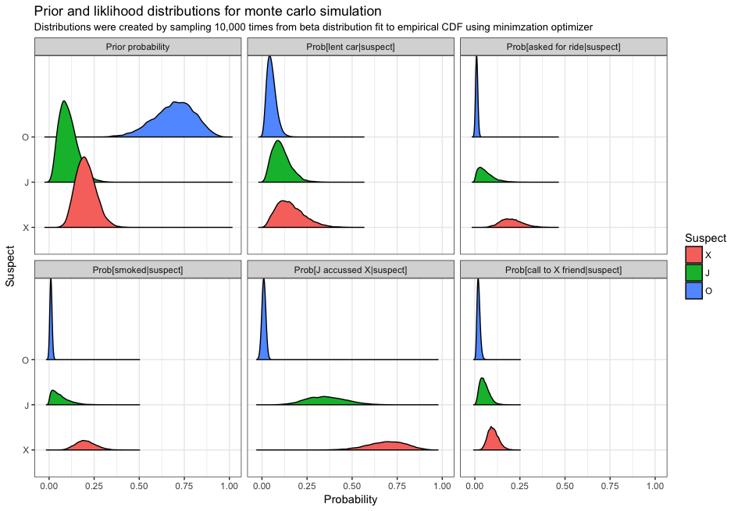


Slide 11
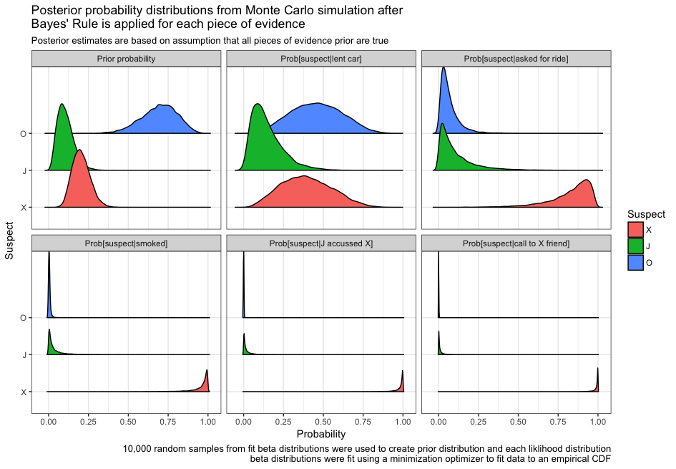
Notes:
the peak changes the most from the 2nd evidence thus has the most diagnostic benefit (why its different from ours: prob is already so high once it gets to the 4th evidence)

Slide 12
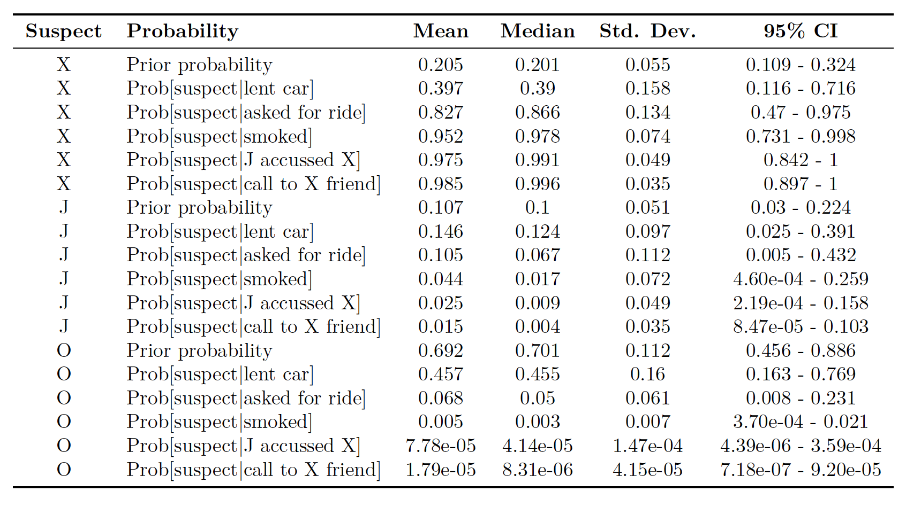
Results from Posterior Uncertainty Analysis

Slide 13
Interpretation: Bayesian vs. Intuitive
Bayesian
P [X guilty] = 0.99
P [J guilty] = 0.01
P [O guilty] = 0.00
Evidence 2 (ask for ride) highest diagnostic benefit
Intuitive
P [X guilty] = 0.50
P [J guilty] = 0.30
P [O guilty] = 0.20
Evidence 4 (J implicated X) most influential
Compare and contrast the Bayesian and the intuitive assessment. Did the two methods provide consistent or conflicting results? If there were differences do you think these differences were because of the different approaches, because you learned more about the case by the time you conducted the Bayesian assessment, because you reflected more on the evidence during the Bayesian approach, or other factors?

Slide 14
Interpretation: Bayesian vs. Intuitive
Which method would you use for making inferences? Which approach should be used by the legal system? You are not the first people to tackle these questions so reference the work of others as appropriate.

Slide 15
References
BJS 2009. “Female Victims of Violence,” Bureau of Justice Statistics, U.S. Department of Justice, available online at: http://www.bjs.gov/content/pub/pdf/fvv.pdf, accessed January 10, 2015.
Guiran, Dr. Patrick. 2018. “Critical Thinking About Evidence.”
Kammen, Daniel M, and David M Hassenzahl. 2001. “Should We Risk It?” In, 128–34. Princeton University Press.
Koenig, Sarah. 2014. “Serial, Season 1.” WBEZ Chicago. http://serialpodcast.org/.

